Slide 1





Web Technologies Basics
HTTP, Servers, Clients
Express.js Development
SoftUni Team
Technical Trainers
Software University
http://softuni.bg

Slide 2



Table of Contents
WWW, URL and HTTP
AJAX and Developer Tools
Overview of Node.js
IDE setup
Node Event Loop
Modules
Basic Web Server

Slide 3
Have a Question?
sli.do #express-js

Slide 4

WWW and URL
What is WWW ? What is URL ?

Slide 5

What is WWW?
WWW = World Wide Web = Web
Global distributed information system in Internet
Consists of set of documents (and other resources) located on different Internet servers
Web servers provide Web content
Web browsers display the Web content

Slide 6


WWW Structural Components
Structural components
Internet – provides data transfer channels over the TCP and HTTP protocols
Clients (Web browsers) – display Web content
Web servers – IIS, Apache, Tomcat, GWS, etc.
Web Client
Web Server

Slide 7
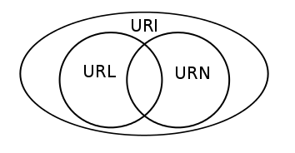

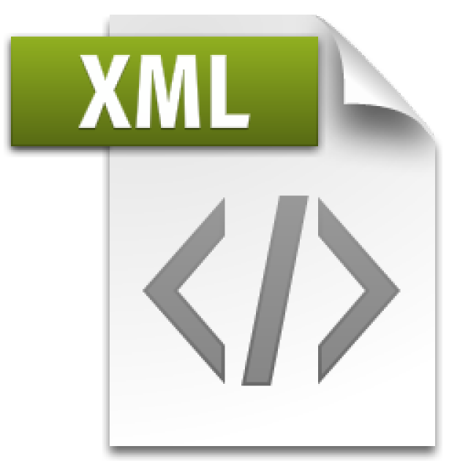
WWW Semantic Components
Semantic components
Hyper Text Transfer Protocol (HTTP)
Hyper Text Markup Language (HTML)
Uniform Resource Locator (URL)
Uniform Resource Identifiers (URIs)

Slide 8

WWW Infrastructure
Clients use Web browser application to request resources from the Web servers via HTTP
Servers send the requested resource as a response
Web pages are resources in WWW
Web sites are sets of Web pages in WWW

Slide 9
Web site components
Web Page
Home
Web Site
About
Contacts

Slide 10
Uniform Resource Locator (URL)
http://mysite.com:8080/demo/index.php?id=27&lang=en#lectures
Protocol
Host
Port
Path
Query String
Fragment
URL is a formatted string, consisting of:
Protocol for communicating (http, ftp, https...) – HTTP in most cases
Host or IP address (www.softuni.bg, gmail.com, 127.0.0.1, web)
Port (the default port is 80) – a number in range [0…65535]
Path (/forum, /path/index.php)
Query string (?id=27&lang=en)
Fragment (#lectures) – used on the client to navigate to some section

Slide 11
URL Encoding
URLs are encoded according RFC 1738:
All other characters are escaped with the formula:
Example: space has decimal code 32, in hex – 20, so space in URL becomes %20
Space can also be encoded as "+"
“... Only alphanumeric [0-9a-zA-Z], the special characters $-_.+!*'() and reserved characters used for their reserved purposes may be used unencoded within an URL.”
%[character hex code in ISO-Latin character set]

Slide 12
URL – Examples
Some valid URLs:
Some invalid URLs:
http://www.google.bg/search?sourceid=navclient&ie=UTF-8&rlz=1T4GGLL_enBG369BG369&q=http+get+vs+post
http://bg.wikipedia.org:80/wiki/%D0%A2%D0%B5%D0%BB%D0%B5%D1%80%D0%B8%D0%B3
http://www.google.bg/search?&q=C# .NET 4.0
http://www.google.bg/search?q=C%23+.NET+4.0
http://www.google.bg/search?&q=бира
http://www.google.bg/search?q=%D0%B1%D0%B8%D1%80%D0%B0

Slide 13
What Do the Web Servers Do?
All physical servers have hardware
Web servers are software products that use the operating system to handle web requests
Web servers serve Web content
These requests are redirected to other software products (Node.js, ASP.NET, PHP, etc.), depending on the web server settings

Slide 14

HTML, XML, JSON, RSS
Comparing the Common Web Data Formats

Slide 15
HTML
Hyper Text Markup Language (HTML)
Notation for describing formatted text with images and hyperlinks
Interpreted and displayed by the Web browsers
A Web (HTML) page consists of:
HTML file
CSS stylesheet file (optional)
A bunch of images (optional)
Other resources (optional)

Slide 16
HTML – Example
<html>
<head><title>HTML Example</title></head>
<body>
<h1>Heading 1</h1>
<h2>Sub heading 2</h2>
<h3>Sub heading 3</h3>
<p>This is my first paragraph</p>
<p>This is my second paragraph</p>
<div align="center"
style="background:skyblue">
This is a div</div>
</body>
</html>

Slide 17
XML
XML stands for Extensible Markup Language
Text-based format
Provide data and meta-data in the same time
<?xml version="1.0"?>
<library>
<book><title>HTML 5</title><author>Bay Ivan</author></book>
<book><title>WPF 4</title><author>Microsoft</author></book>
<book><title>WCF 4</title><author>Kaka Mara</author></book>
<book><title>UML 2.0</title><author>Bay Ali</author></book>
</library>

Slide 18
JSON
JSON (JavaScript Object Notation)
Standard for representing simple data structures and associative arrays
Lightweight text-based open standard
{
"firstName": "John",
"lastName": "Smith",
"age": 25,
"address": { "streetAddress": "Stud. Grad 36 Sofia" }
}

Slide 19
RSS
RSS (Really Simple Syndication)
Family of Web feed formats for publishing frequently updated works
E.g. blog entries, news headlines, videos, etc.
Based on XML, with standardized XSD schema
RSS documents (feeds) are list of items
Each containing title, author, publish date, summarized text, and metadata
Atom protocol aimed to enhance / replace RSS

Slide 20
RSS – Example
<?xml version="1.0" encoding="utf-8" ?>
<rss version="2.0">
<channel>
<title>W3Schools Home Page</title>
<link>http://www.w3schools.com</link>
<description>Free web building tutorials</description>
<item>
<title>RSS Tutorial</title>
<link>http://www.w3schools.com/rss</link>
<description>New RSS tutorial on W3Schools</description>
</item>
<item>
<title>XML Tutorial</title>
<link>http://www.w3schools.com/xml</link>
<description>New XML tutorial on W3Schools</description>
</item>
</channel>
</rss>

Slide 21

The HTTP Protocol
How HTTP Works?

Slide 22
HTTP
Hyper Text Transfer Protocol (HTTP)
Client-server protocol for transferring Web resources (HTML files, images, styles, etc.)
Important properties of HTTP
Request-response model
Text-based format
Relies on a unique resource URLs
Provides resource metadata (e.g. encoding)
Stateless (cookies can overcome this)

Slide 23
HTTP: Request-Response Protocol
Client program
Running on end host
E.g. Web browser
Requests a resource
Server program
Running at the server
E.g. Web server
Provides resources
GET /index.html
HTTP/1.0
HTTP/1.0 200 OK
"Welcome to our
Web site!"

Slide 24
Example: Hyper Text Transfer Protocol
HTTP request:
HTTP response
GET /courses/about.aspx HTTP/1.1
Host: www.softuni.com
User-Agent: Mozilla/5.0
<CRLF>
End of request header
HTTP/1.1 200 OK
Date: Mon, 5 Jul 2010 13:09:03 GMT
Server: Microsoft-HTTPAPI/2.0
Last-Modified: Mon, 12 Jul 2010 15:33:23 GMT
Content-Length: 54
<CRLF>
<html><title>Hello</title>Welcome to our site</html>

Slide 25
HTTP Request Message
Request message sent by a client consists of
Request line – request method (GET, POST, HEAD, ...), resource URI, and protocol version
Request headers – additional parameters
Body – optional data
E.g. posted form data, files, etc.
<request method> <resource> HTTP/<version>
<headers>
<empty line>
<body>

Slide 26
HTTP Request Methods
HTTP defines methods to indicate the desired action to be performed on the identified resource
Method | Description
GET | Retrieve / load a resource
POST | Create / store a resource
PUT | Update a resource
DELETE | Remove a resource

Slide 27
HTTP Response Message
Response message sent by the server
Status line – protocol version, status code, status phrase
Response headers – provide meta data
Body – the contents of the response (the requested resource)
HTTP/<version> <status code> <status text>
<headers>
<CRLF>
<response body – the requested resource>

Slide 28
Content-Type and Disposition
The Content-Type header at the server specifies how the output should be processed
Examples:
UTF-8 encoded HTML page. Will be shown in the browser
Content-Type: text/html; charset=utf-8
Content-Type: application/pdf
Content-Disposition: attachment;
filename="Financial-Report-April-2010.pdf"
This will download a PDF file named Financial-Report-April-2010.pdf

Slide 29
HTTP Response Codes
HTTP response code classes
1xx: informational (e.g., "100 Continue")
2xx: successful (e.g., "200 OK", "201 Created")
3xx: redirection (e.g., "304 Not Modified", "301 Moved Permanently", "302 Found")
4xx: client error (e.g., "400 Bad Request", "404 Not Found", "401 Unauthorized", "409 Conflict")
5xx: server error (e.g., "500 Internal Server Error", "503 Service Unavailable")

Slide 30
HTTP Cookies
Cookie
Cookies are small pieces of data stored by the client on behalf of the server
Included in all future HTTP requests to the server
Request
Response
Set-Cookie: XYZ
Next request
Cookie: XYZ

Slide 31
Cookies – Example
The client requests some URL:
The server sets a cookie in the HTTP response:
In further requests to google.bg the Web browser sends the cookie in the HTTP header:
GET / HTTP/1.1
Host: www.google.bg
HTTP/1.1 200 OK
Set-Cookie: PREF=ID=c0bf5fd5c3a25209; expires=Wed, 11-Jul-2012 16:13:22 GMT; domain=.google.bg
GET / HTTP/1.1
Host: www.google.bg
Cookie: PREF=ID=c0bf5fd5c3a25209

Slide 32

AJAX
Asynchronous JavaScript and XML

Slide 33

What is AJAX ?
AJAX == Asynchronous JavaScript And XML
Technique for background loading of dynamic content / data
Web pages / apps load data from the Web server and render it
Two types of AJAX
Partial page rendering
Load HTML fragment + show it in a <div>
JSON service
Load JSON object and display it with JavaScript / jQuery

Slide 34

Web Developer Tools
You Will Be Dead Without Them!

Slide 35
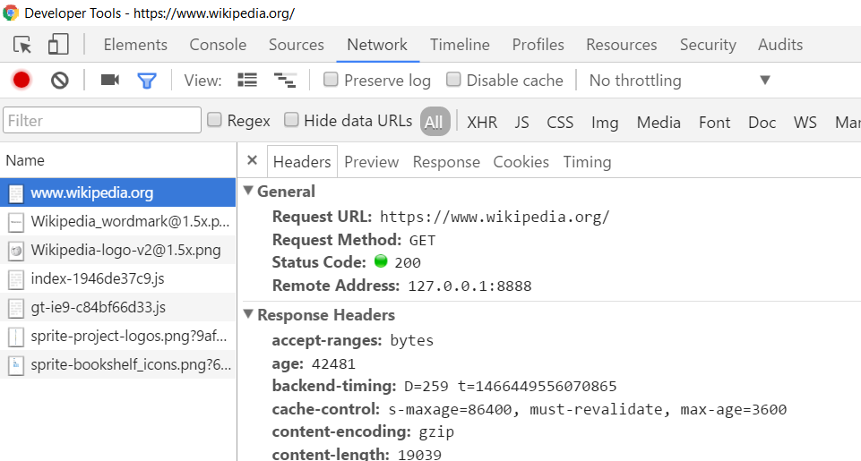
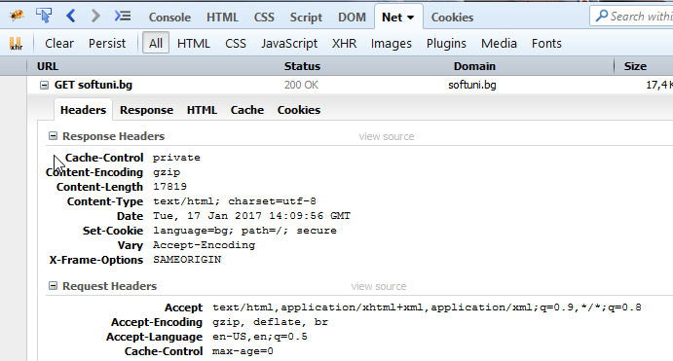

HTTP Tools for Developers
Chrome Developer Tools
Firebug
Postman

Slide 36

Overview of Node.js
History, Components, Installation

Slide 37
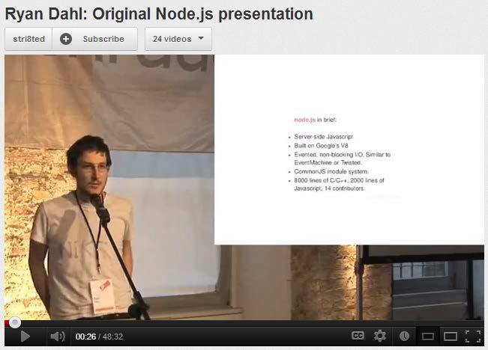

Overview of Node.js
History and Components
Created in 2009 by Ryan Dahl
Addresses the issues of then popular servers
V8, Event Loop, libuv
Advantages
One language for server and client
Fast and asynchronous
Efficient package manager

Slide 38
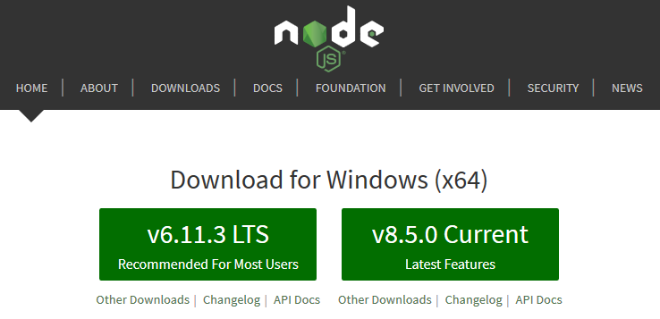
Installation
Installation
Go to http://nodejs.org
To confirm installation, type in command prompt (terminal):
node -v

Slide 39
How to Use
From the terminal
Interpret code from a file
Save script to index.js
Execute from the terminal:
node // Start REPL
let a = 5
let b = 3
a + b // 8
node index.js // 8

Slide 40
NPM Packages
Node.js projects are usually set up as NPM packages
From the terminal, inside the target directory :
Answer questions to initialize project
A package.json file will be created with initial configuration
To bypass all questions (take default values):
npm init
npm init -y

Slide 41
Configuration (package.json)
{
"name": "demo",
"version": "1.0.0",
"description": "Node.js demo project",
"main": "index.js",
"engine": "8.5.0",
"scripts": {
"start": "node index.js"
},
"keywords": [],
"author": "",
"license": "ISC“
}
Target version on the server
Aliases for executing
node commands

Slide 42





IDE Setup
Development Environments for Node.js

Slide 43




Configuring Visual Studio Code
Download from https://code.visualstudio.com/
Official Node.js instructions can be found at:
Recommended linters:
https://code.visualstudio.com/docs/runtimes/nodejs

Slide 44

The Event Loop
The Core Node Component

Slide 45


The Event Loop
Long-running processes
Order of completion
is not guaranteed

Slide 46
Stack Execution
The Stack
The Heap
function

Slide 47
Stack Execution
The Stack
The Heap
function
function
function
Function call
Execution returns

Slide 48
Stack Execution
The Stack
The Heap
Program finished

Slide 49
The Event Loop
The Stack
The Heap
function
function
function
Event Queue
event
Event placed in the queue

Slide 50
The Event Loop
The Stack
The Heap
Execution stack
is empty
function
function
function
Event Queue
event

Slide 51
The Event Loop
The Stack
The Heap
Event callback is executed
function
Event Queue
event

Slide 52
Asynchronous Code
The synchronous way
Operations are
carried out in order
var conn = getDbConnection(connectionString);
var stmt = conn.createStatement();
var results = stmt.executeQuery(sqlQuery);
for (var i=0; i<results.length; i++) {
// print results[i];
}

Slide 53
Asynchronous Code
The Node.js asynchronous way
Callbacks are invoked when the result is ready
getDbConnection(connectionString, function (err, conn) {
conn.createStatement(function (err, stmt) {
var results = stmt.executeQuery(sqlQuery);
results.on('row', function(result) {
// print result
});
});
});
…
Code execution continues
while waiting for response

Slide 54
Conventions
The function callback is the last parameter in the call
Error is the first parameter in the callback
Always check errors and handle them correctly!
function handleResults (error, results) {
// if error is undefined…
// do something with the results
}
getStuff(inputParam, handleResults);
Callback
Calling function

Slide 55
Asynchronous Code in ES6
Allows asynchronous code to be composed like it is synchronous
Requires Node.js version 7.6.0 to work
let conn = await getDbConnection(connectionString);
let stmt = await conn.createStatement();
let results = await stmt.executeQuery(sqlQuery);
for (let result of results) {
// print result;
}

Slide 56
Using Modules
Making Our App Modular

Slide 57
What is a Module?
persons.js
class Person {
constructor(name) {
this.name = name;
}
toString() {
return `I'm ${this.name}`;
}
}
module.exports = Person;
app.js
let Person = require('./person');
let p = new Person('Pesho');
console.log(p.toString());

Slide 58
How To Use Modules
Modules allow larger apps to be split and organized
To expose a module
To use a module from another file
module.exports = Person;
module.exports = { getById, getAll, update };
let Person = require('./Person');
let api = require('./api');
let getById = require('./api').getById;
let { getById } = require('./api');

Slide 59
Built-in Modules
Node.js comes with a plethora of useful modules
Imported with a string identifier
Commonly used modules
fs, http, crypto, os
More at https://nodejs.org/api/
var fs = require('fs');

Slide 60
Your Modules
first.js
var count = 2;
var doIt = function(i, callback) { … }
module.exports.doIt = doIt;
module.exports.someVar = 'result';
second.js
var one = require('./first');
one.doIt(23, function (err, result) {
console.log(result);
});
console.log(one.someVar);
console.log(one.count); // invalid

Slide 61
Third-Party Modules
Installed from Node Package Manager (NPM)
Run from the terminal
To use in your code
To install globally (for use from the terminal)
npm install --save express --save-exact
let express = require('express');
npm install -g mocha

Slide 62
Node.js Web Server
Let's start the fun!

Slide 63
What Do the Web Servers Do? (Again)
All physical servers have hardware
The hardware is controlled by the operating system
Web servers are software products that use the operating system to handle web requests
Web servers serve Web content
These requests are redirected to other software products (ASP.NET, PHP, etc.), depending on the web server settings

Slide 64
A Simple Node.js Web Server
Let's write a simple Node.js web server
const http = require('http')
http.createServer((req, res) => {
res.write('Hi!')
res.end()
}).listen(1337)
console.log('Node.js server running on port 1337')

Slide 65
Summary
Web Servers transfer resources to the Client
The Node.js Event Loop runs slow tasks in the background asynchronously
You can organize your code with modules
NPM allows quick access to external modules
let express = require('express');
npm init -y
npm install --save socket.io

Slide 66












HTTP and Node.js Introduction
https://softuni.bg/courses/

Slide 67
License
This course (slides, examples, demos, videos, homework, etc.) is licensed under the "Creative Commons Attribution-NonCommercial-ShareAlike 4.0 International" license

Slide 68





Trainings @ Software University (SoftUni)
Software University – High-Quality Education, Profession and Job for Software Developers
softuni.bg
Software University Foundation
http://softuni.foundation/
Software University @ Facebook
facebook.com/SoftwareUniversity
Software University Forums
forum.softuni.bg

